Slide 1
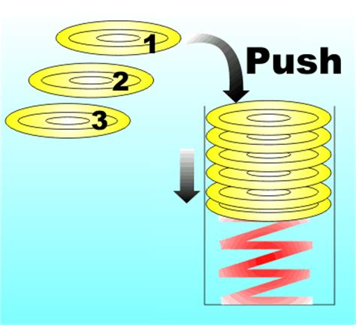
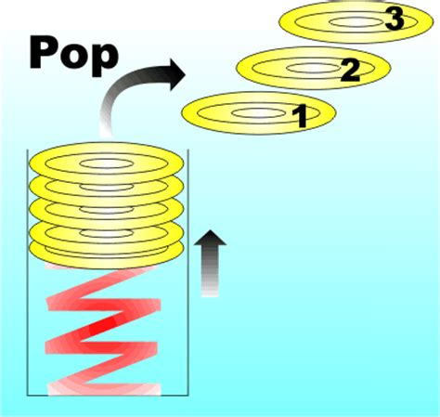
Methods Pass by Value and Software Development

Slide 2
Check In
Quiz module 02
GE 03 Loops and Methods - when is it due? What must you submit?
Goals
Design solutions by decomposing into methods
Examine passing values to methods
Understand scope and Stack frames
Software Development

Slide 3
1. Trace Code
public class M03LoopsConditinsMethods
{
public static void main(String[] args) {
String startingString = "SquarePants";
methodOutputs(startingString);
System.out.printf("\nString after method: %s", startingString);
}
public static void methodOutputs(String stringParameterInput)
{
int stringLength = stringParameterInput.length();
for (int i = (stringLength-1); i >= 0; i--)
{
char currentChar = stringParameterInput.charAt(i);
if (currentChar == 'a' || currentChar == 'e' || currentChar == 'i' ||
currentChar == 'o' || currentChar == 'u') {
currentChar = Character.toLowerCase(currentChar);
}
else {
currentChar = Character.toUpperCase(currentChar);
}
System.out.print(currentChar);
}
}
}
1. Write down what the output will be for the problem below.

Slide 4
2. Algorithms
On paper write an algorithm in pseudocode for a method and include the following for each of the three problems below.
Create two test cases
Start the algorithm with the method return value, method name and parameters.
Write the method algorithm using pseudocode
1 Method Algorithm to swap two integer numbers that are passed to the method so the first number is stored in the second number variable and the second number is stored in the first number variable. Displays first and second number before and after swap.
2 Method algorithm that repeats prompting for integer number until number is positive and returns positive integer number.
What type of structures would be best?

Slide 5
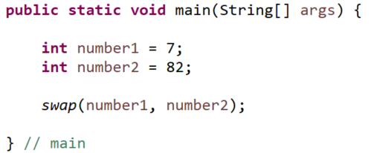
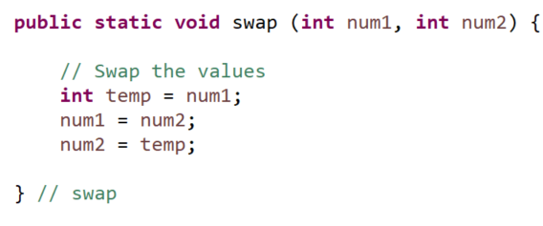
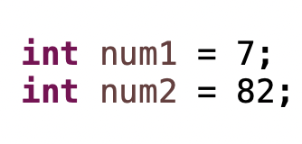
3. Scope
When is a variable declared? What happens when a variable is declared?
Match the following variables with the letter for scope
3.1 num1 in main
3.2 num2 in main
3.3 num1 in swap
3.4 num2 in swap
3.5 temp in swap
Only in main
In main and in swap
Only in swap method
num1, num2

Slide 6
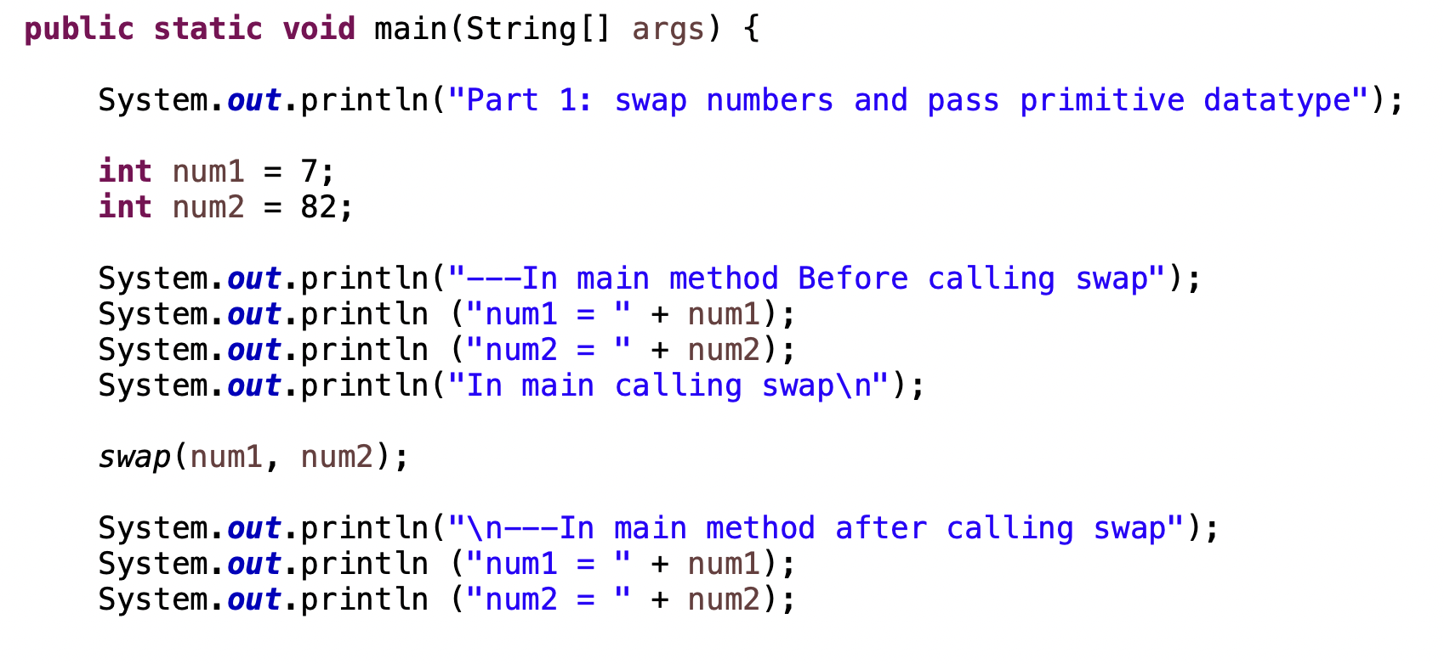
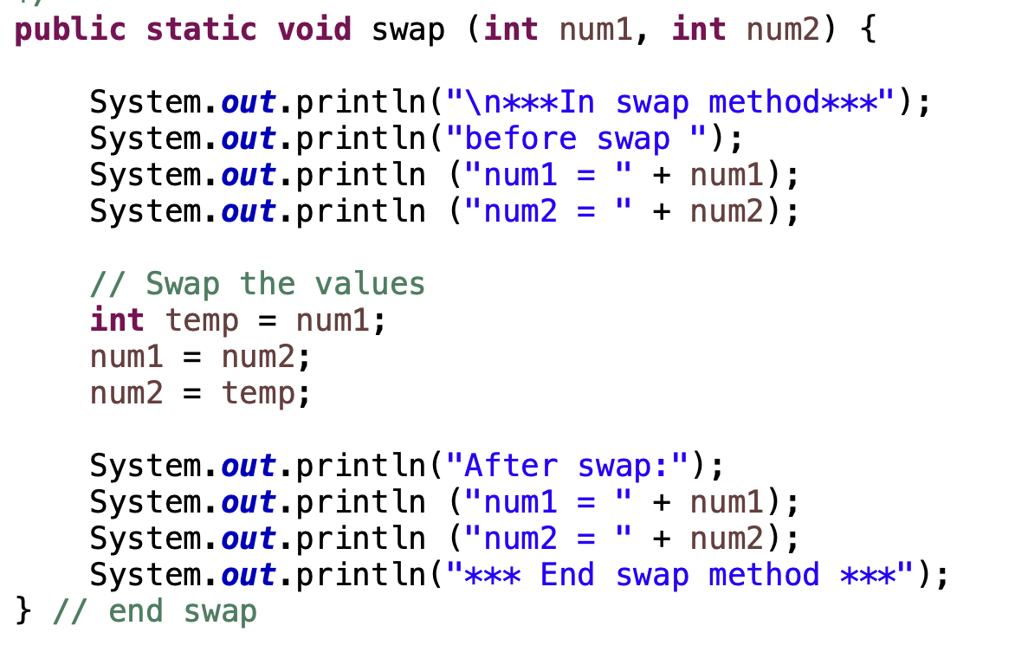

4. Trace Code
4. Write down what the output will be for the code below starting in main method and calling swap method.

Slide 7
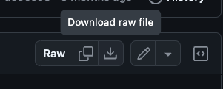
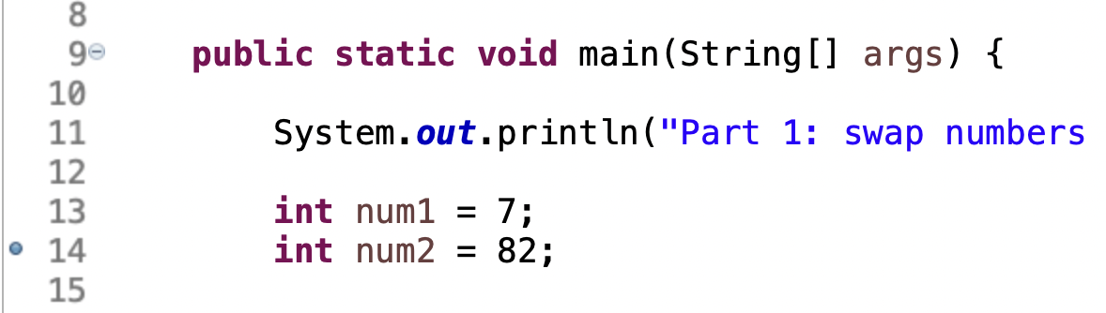
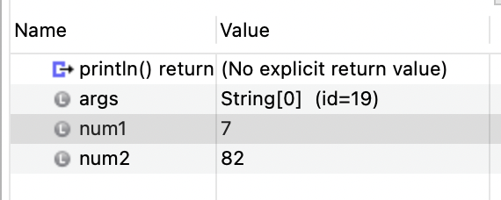
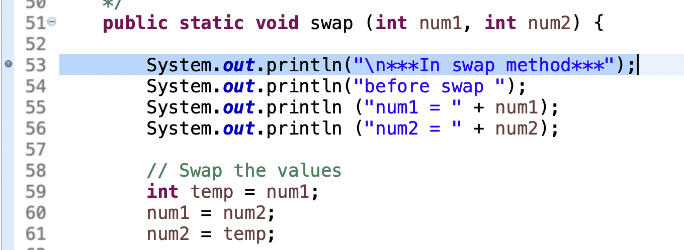
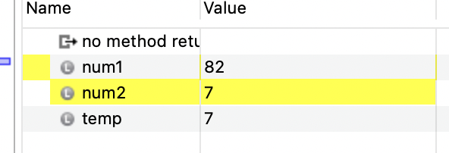
Step Through Code
Download and import Swap Code. (How to Add Existing Files to Eclipse Projects - DZone ) Set the breakpoints shown below and step through code. Notice what is being stored in variables when in main method and when in swap method. Stop when you get to part 2.

Slide 8
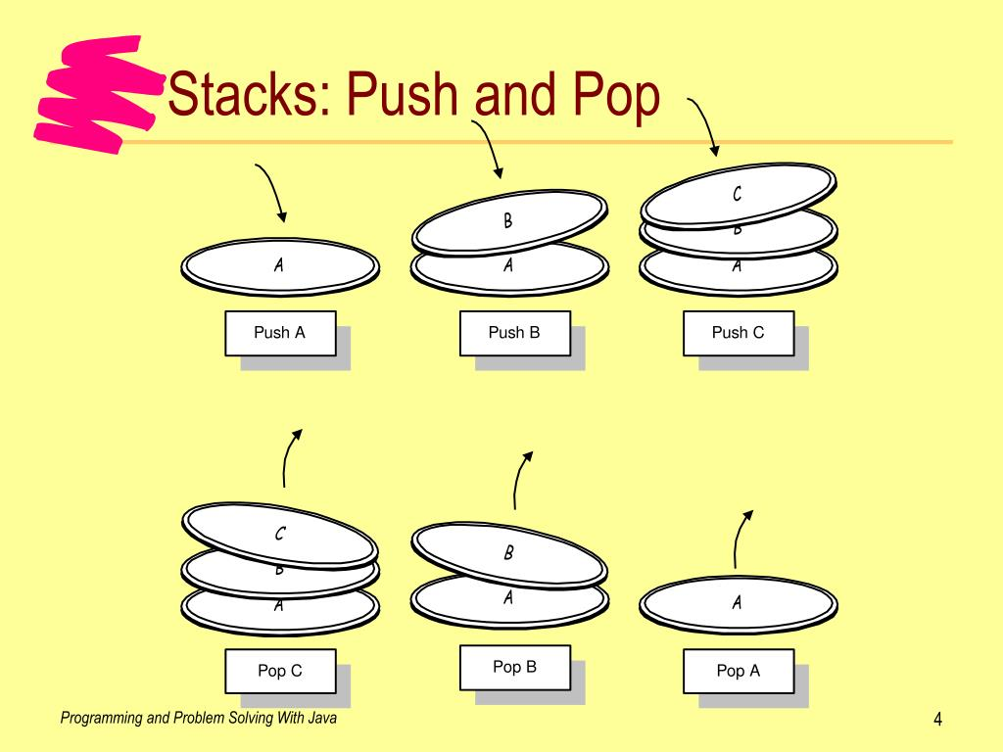
Call and Stack Frame
The call stack is used to keep track of active methods. Stacks are last in, first out (LIFO) last item pushed onto stack is 1st item popped off
The call stack is used to keep track of active methods. When method is called (invoked) information for that method called a stack frame is pushed onto the stack - (add) a plate onto the stack
Values of parameters and local variables (automatic storage duration)
Current line of code executing
Return address to return to calling function
Method on the top of stack is the current executing method.
Method stays on top until the ending curly brace is reached
When the Method returns (completes)
Information for that method is popped off the stack (frame is removed)
Memory local to that stack is deallocated
Think of stack of plates at buffet line

Slide 9

Memory and Calling Methods
swap
2. When main method calls swap method it allocates memory in a new location.
When variables are declared in swap method new memory is allocated
Variable declared in swap method only have scope in wasp method.
1. Main methods loads in memory first.
When variables are declared in main, memory is allocated in relation to the main method
Variables declared in main method { } only have scope in main.
m
ain
Since these are separate memory locations it is best practice to not use same variable names.

Slide 10
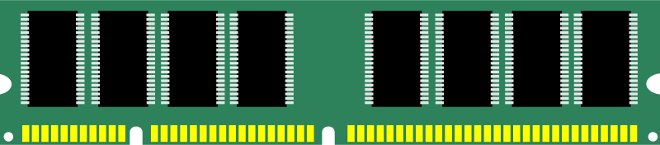

Methods, Stacks and Memory
Main method called first and stack created in memory for declared variables in main method.
Then swap invoked (called) and another stack of memory for declared variables in swap method
2.These variables are in a separate swap stack of memory and once the method ends the memory is deallocated (deleted)
0x7fff6771c324
What happens to the memory allocated after swap method ends?
0x7fff6771c456
0x7fff677af799
1. Memory allocated with main stack
Rename so different from parameter names in method below
0x7fff6771h587
0x7fff6771g123

Slide 11
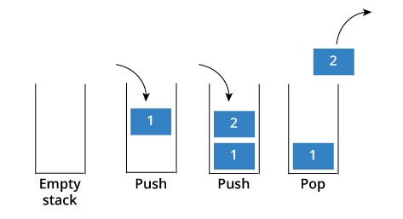



Call and Stack Frames
2 swap method stack
1 main method stack
User defined method swap ends and memory (parameters/local) released
Main method calls user defined method swap;
when variables (parameters/local) are declared space is allocated in memory based on the type
Main method ends and memory released
Run program calls main method; when variables are declared space is allocated in memory based on the data type

Slide 12

Pass by Value
When passing primitive data types from one method to another we are passing-by-value.
What are primitive data types? What are examples?
copy
copy
Pass by value means a copy of the value from one memory location is put in another memory location. Even if you would make the formal parameter names the same they are still located in two different memory locations. Remember to not use the same variable names for
Look at part 2 code.
Give an example of a method and parameter that is pass by value.
Give an example of a method and parameter that is not pass by value.

Slide 13
public class M03LoopsConditinsMethods
{
public static void main(String[] args) {
String startingString = "SquarePants";
methodOutputs(startingString);
System.out.printf("\nString after method: %s", startingString);
}
public static void methodOutputs(String stringParameterInput)
{
int stringLength = stringParameterInput.length();
for (int i = (stringLength-1); i >= 0; i--)
{
char currentChar = stringParameterInput.charAt(i);
if (currentChar == 'a' || currentChar == 'e' || currentChar == 'i' ||
currentChar == 'o' || currentChar == 'u') {
currentChar = Character.toLowerCase(currentChar);
}
else {
currentChar = Character.toUpperCase(currentChar);
}
System.out.print(currentChar);
}
}
}
What is printed out?

Slide 14
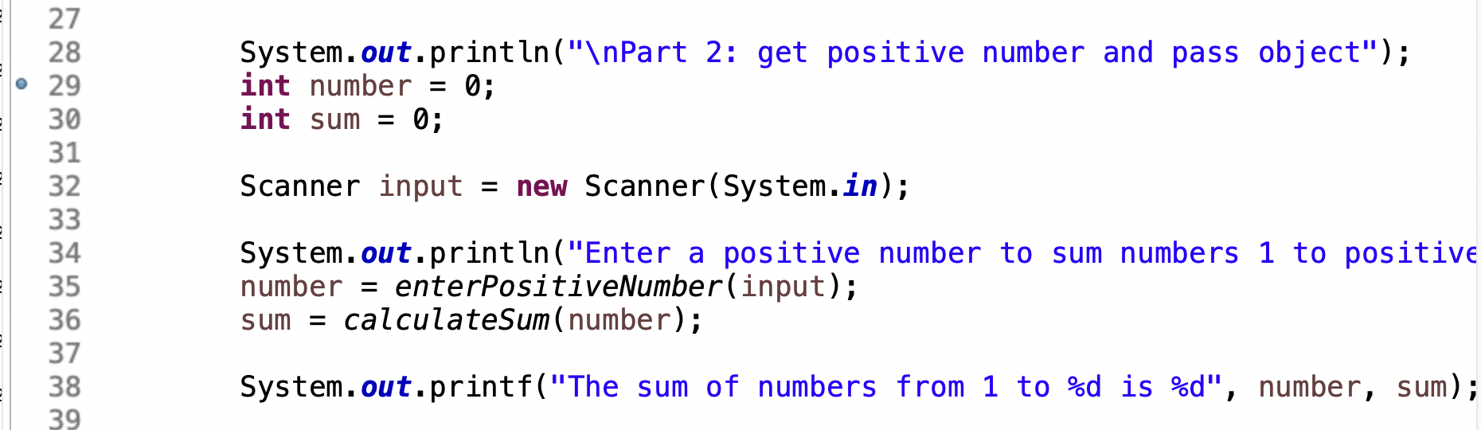
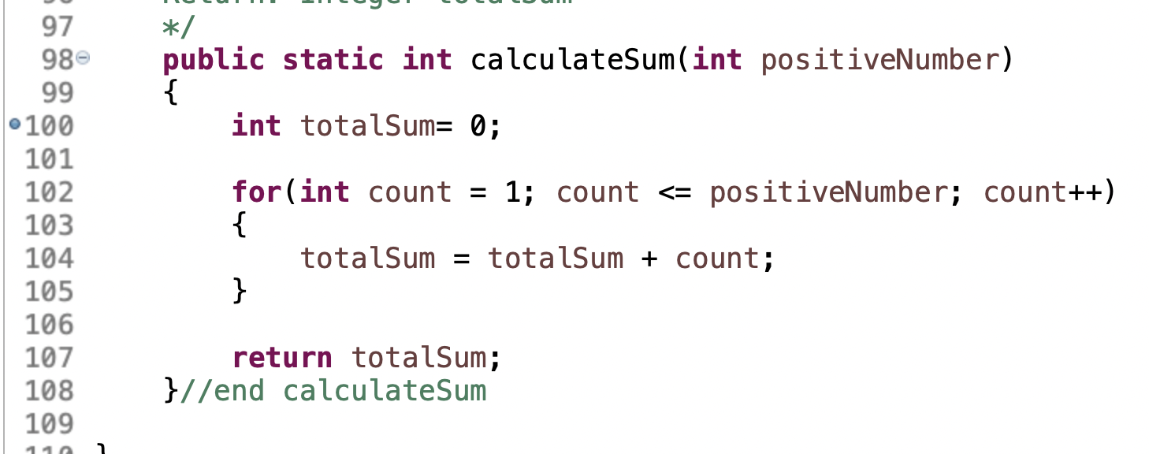
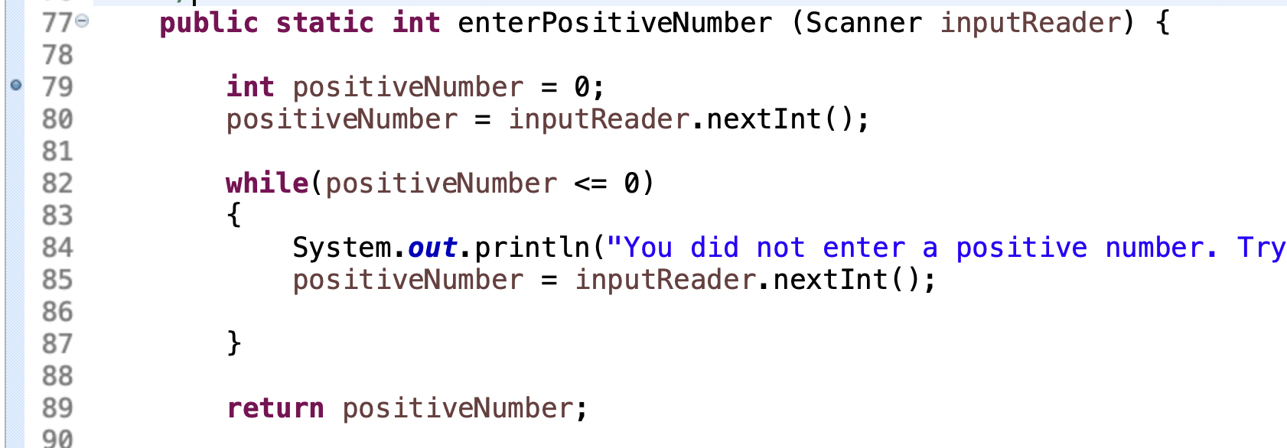
Part 2: Passing Objects
Remove breakpoints for part 1. Set breakpoint in main for part2 as shown below for main, calculateSum and enterPositiveNumber

Slide 15
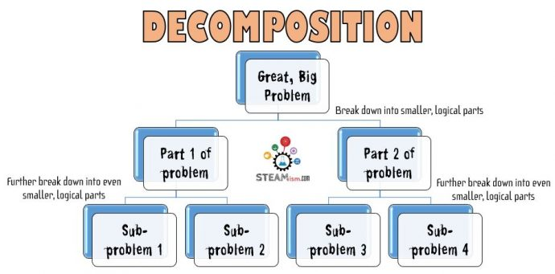
Decomposition of a Problem
What is decomposition?
Why Use Methods?
What is modular programming?
How can you design a modular solution?
What do you think single responsibility principle (SRP) means?
What do you thin do not repeat yourself (DRY) means?
Open Agile Software Development

Slide 16
Preparation
Discussion: Using the code in part 2 main method that calls enterPositiveInteger and calculateSum explain:
1. The stack frames that are called and what is happening in memory.
2. What is being passed by value and what is not being passed by value.
Go to canvas and complete participation. Then work on GE03

